Slide 1
Economics and Business Administration
Technology and Innovation: managerial and economic implications
Prof. Leonardo Boni

Slide 2

From film to digital cameras

Slide 3
Why the Change is Competence‐destroying
Fim Technology
Visible
Manual-intensive Manufacturing Culture Scale-related
Longer product lifecycle
Digital Technology
Invisible
Brain-intensive R&D Culture Scope-related
Shorter product lifecycle

Slide 4
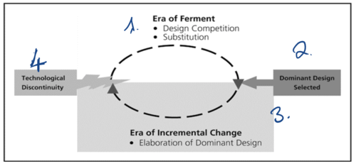
Technology and Innovation Cycles
Fluid Product innovation
Fluid
Process innovation

Slide 5
Technology discontinuity
Technological Change can be competence‐enhacing or competence‐destroying
Technological discontinuities are typically competence‐destroying
Competence- enhacing
Competence- destroying

Slide 6
Types of Innovation and Dominant Designs

Slide 7
Types of innovation
Innovation can be related to product or to processes
Product
Product
Process
Innovation
Innovation

Slide 8
Types of innovation
Product Innovation can be radical or incremental according to the combination of newness and the degree of diversity
Incremental
Radical
Innovation
Innovation

Slide 9
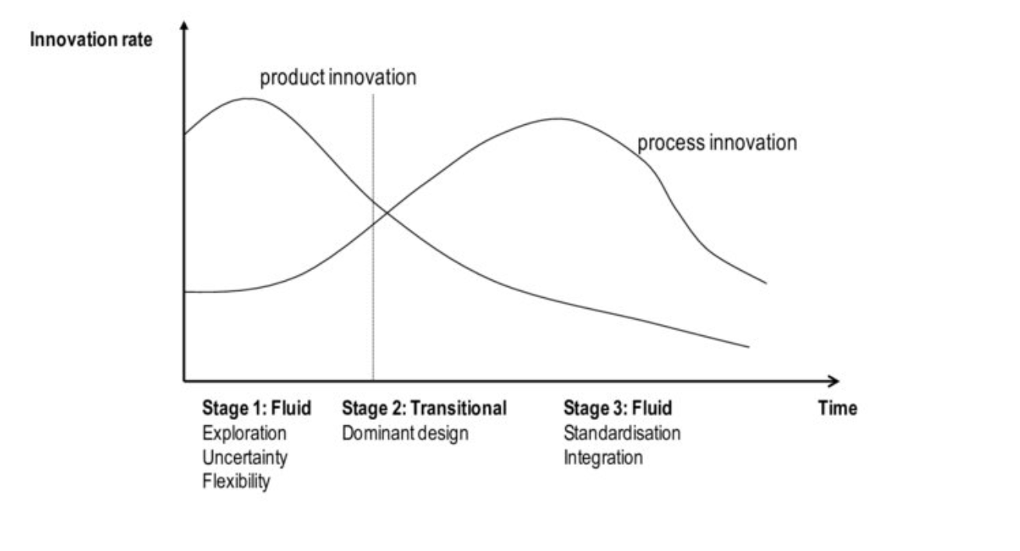
Abernathy‐Utterback (1978)
Technology regards machineries, tools, and knowledge that are embedded in products and services (product technology) and machineries, tools, and knowledge that mediate between inputs and outputs (process technology) (Rosenberg, 1972)

Slide 10
Abernathy‐Utterback (1978)
In the fluid phase, innovation is largely radical. Firms explore fundamentally different product architectures, technologies, and value propositions. Uncertainty is high and learning is exploratory. Radical innovation here is not only technological but also market-related, because firms are still discovering user needs and viable applications.
As the industry moves into the transitional phase, the emergence of a dominant design reduces uncertainty.
Radical product innovation declines sharply, and innovation becomes mainly incremental, especially at the product level. At the same time, firms invest in significant changes in production methods and organization, which can be radical in a process sense but are aimed at stabilizing the dominant design rather than redefining it.
In the specific or mature phase, innovation is overwhelmingly incremental. Firms focus on refinements, cost reductions, quality improvements, and efficiency gains. Radical innovation becomes rare and is often competence-destroying for incumbents when it appears, typically originating outside the industry and triggering a new fluid phase.

Slide 11
A Dominant Design
A Dominant Design is a product design that is adopted by the majority of the producers typically creating a stable architecture on which the industry can focus its efforts – Shane, 2009

Slide 12
What makes an economic system creative and advancing? (Mokyr, 1990)
‐ Innovators
‐ Institutions
‐ Diversity and Tolerance

Slide 13
Teece – Profiting from Technological Innovation
What makes innovation be profitable and worthy for innovators(Mokyr, 1990)
How do firms profit from technological innovation?
  License to others
  Develop it
The choice depends on
  Appropriability: possibility to appropriate profitability with proer legal regimes
  Complementary assets: having those competences, skills and structure that complements innovation skills

Slide 14
Profiting from Technological Innovation
Patent: a right to protect the intellectual property and the commercialization of a well defined and describe innovation. It grants the exclusive use of the innovation
License to others
The firm captures value by granting access to its innovation to external actors in exchange for royalties or fees. This strategy is more attractive when the firm cannot efficiently commercialize the innovation on its own or when downstream assets are controlled by others.
Develop it internally
The firm integrates the innovation into its own production, distribution, or service activities. This allows direct value capture but requires control over key assets and capabilities beyond the technology itself.
The choice depends on two key factors
Appropriability regime
In Teece’s terms, appropriability refers to the effectiveness of legal and strategic mechanisms that allow innovators to protect their returns from imitation. Strong appropriability, for example robust patents or trade secrets, enables firms to license innovations without losing control. Weak appropriability increases the risk of imitation and favors internal development.
Complementary assets
Complementary assets are the non-technological resources required to commercialize an innovation, such as manufacturing, marketing, distribution, after-sales service, or reputation. When these assets are generic and easily accessible, licensing is feasible. When they are specialized, co-specialized, or tightly linked to the innovation, firms that control them are more likely to capture value, often pushing innovators toward integration or strategic alliances.

Slide 15
Market for technology (Gambardella)
The market for technology allows firms to trade technological knowledge separately from products. Patents play a central role by making knowledge excludable, tradable, and contractible. By defining legal ownership over an invention, patents enable transactions between innovators and firms that control complementary assets.
Technology owners (innovators)
Innovators earn money by licensing their patented technology rather than producing goods themselves. Revenues come from upfront license fees and ongoing royalties, typically calculated as a percentage of sales or per-unit payments. This model is attractive when innovators lack manufacturing, distribution, or market access capabilities.
Licensees (producers and incumbents)
Licensees earn money by embedding the licensed technology into products or services they sell on the market. They accept royalty payments because they control complementary assets such as scale manufacturing, branding, distribution channels, or customer relationships, which allow them to commercialize the innovation efficiently.
Royalty structure and value division
Royalties reflect bargaining power and depend on the strength of the patent, the availability of alternative technologies, and the importance of complementary assets. Strong appropriability allows licensors to capture a larger share of value, while control over critical complementary assets allows licensees to retain more profits.
Profits from innovation do not depend only on inventing, but on the ability to protect knowledge and position oneself strategically within the market for technology.
Teece, D. J. (1986). Profiting from technological innovation: Implications for integration, collaboration, licensing and public policy. Research policy, 15(6), 285-305.

Slide 16
Market for Technology are relevant more than ever in the economic system

Slide 17
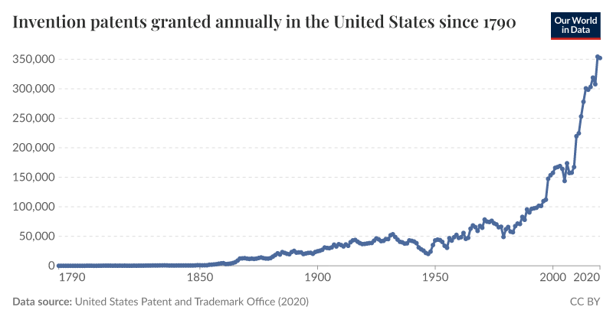

Slide 18
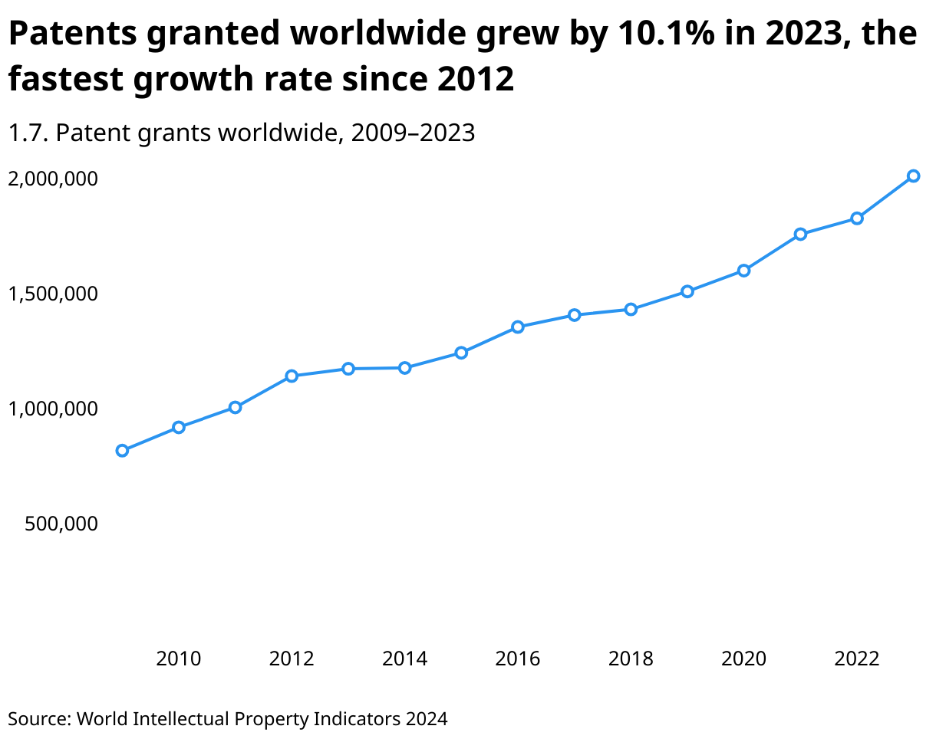

Slide 19
Economics and Business Administration
Technology and Innovation: entrepreneurship and market for research outcomes
Prof. Leonardo Boni

Slide 20
Innovation in large and small firms
What is entrepreneurship?
Why is it important today?
Why are there small and large firms?

Slide 21
Joseph Schumpeter
Theory of Capitalistic Development
  The driver of economic growth is innovation
  One firm innovates (the “entrepreneur”), drives all the demand towards it … gains extra-profits (“temporary monopoly”)
  But over time firms imitate, and dry up all extra profits
  Temporary monopoly is the incentive to innovate, imitation is the gain of society
  The entrepreneur is crucial - the driver of innovation

Slide 22
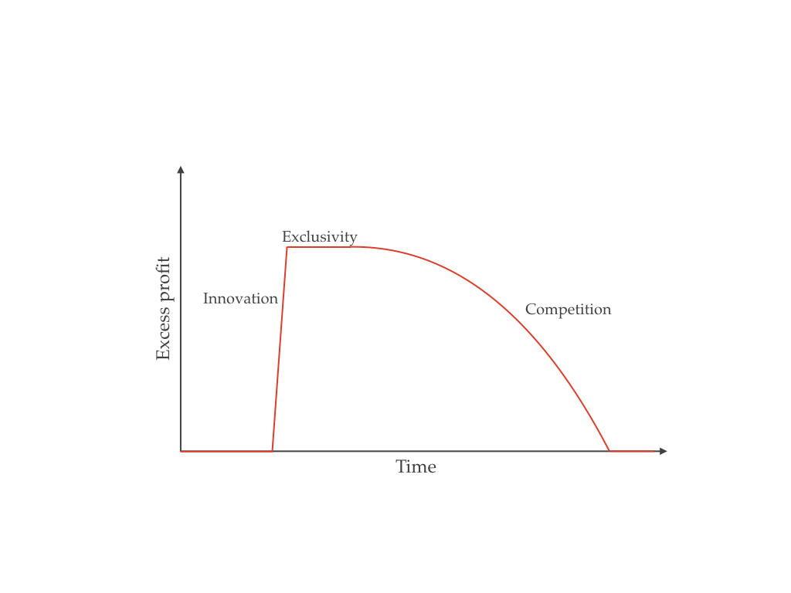
Schumpeter - Theory of Economic Development
Economic development depends on entrepreneurship and and innovation dynamics
New Innovators, growth

Slide 23
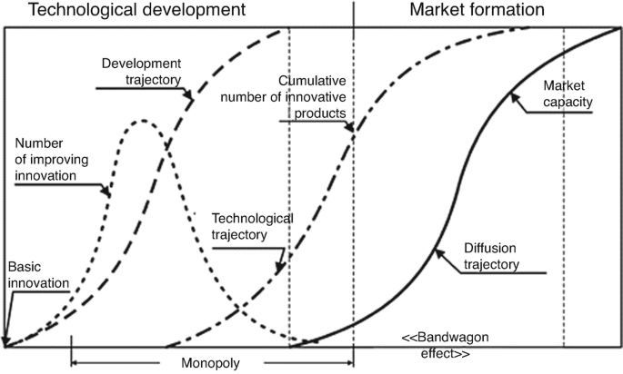

Slide 24
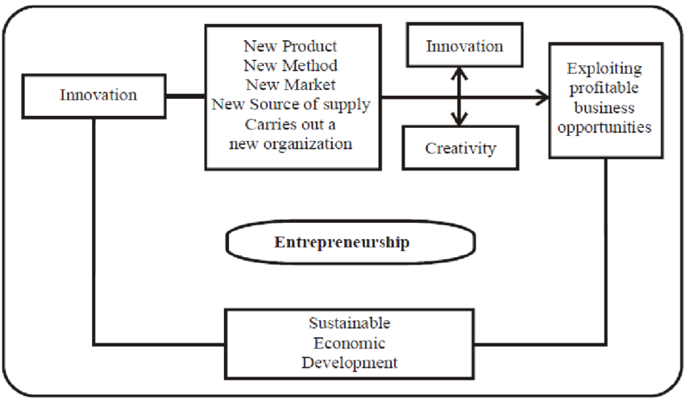
Innovation Theory of Entrepreneurship source – Schumpeter (1949)

Slide 25
Joseph Schumpeter
profits
Temporary monopoly phase, Extra profits
New Innovators, growth
Imitation
time

Slide 26
Joseph Schumpeter
Theory of Capitalistic Development
Trade off:
  You need to allow enough extra-profits in the temporary monopoly phase to provide the incentives to innovate,
  but not too much to allow imitation for society gains (private gains for incentives vs social gains)

Slide 27
Joseph Schumpeter - trade-off
Lots of incentives to innovate but not so good for society
profits
Private profits collapse soon - Good for society, but few incentives to innovate
time

Slide 28
Case 1 - “Good for society, but few incentives to innovate”.
innovations that generate large social benefits very quickly, for example basic research, public goods, or systemic innovations. Society benefits a lot, often immediately, but private profits collapse rapidly or never become significant. These innovations suffer from classic Schumpeterian problems such as appropriability, spillovers, and uncertainty. Markets alone underinvest in them.
Case 2 – “Lots of incentives to innovate”.
Innovations with strong private incentives, protected by market power, scale, or intellectual property. Firms can appropriate profits for a long time. However, as time passes, monopoly rents, lock-ins, and incremental innovation dominate. The innovation becomes less socially beneficial, even if it remains profitable. This is where Schumpeter’s “creative destruction” turns into creative accumulation.
The trade-off is the key point. Innovations that are most valuable for society tend to be those with weak private incentives, while innovations with strong private incentives may generate persistent profits but diminishing or even negative social returns over time. Left alone, the system biases innovation toward what is privately profitable rather than what is socially desirable.

Slide 29
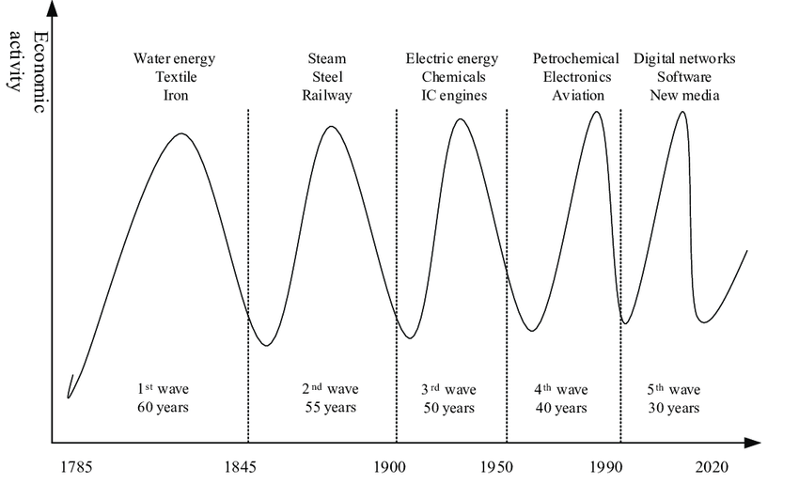
Schumpeters Long Waves of Innovation – Trade off equilibrium
Influence of policy, and regulations to ensure waves to be «soft» in the economic markets

Slide 30
Arrow
Innovation in large and small firms (1993)
Large and small firms exhibit distinct comparative advantages.
In large firms, the allocation of capital is mainly internal and functions tend to be highly specialized, while inventors are typically organizationally distant from those who control financial decisions.
In small firms, access to capital is more constrained, whether sourced internally or externally, but inventors are organizationally closer to financiers and decision makers.

Slide 31
Arrow
Innovation in large and small firms (1993)
What implications for innovation models?
How innovations in large firms are developed?
How innovations in small firms are developed?

Slide 32
Arrow
Innovation in large and small firms (1993)
Large firms are advantaged when R&D projects require substantial scale, as they can mobilize capital at lower cost, both internally and externally. At the same time, the greater organizational distance between inventors and financial decision makers increases asymmetric information, which disproportionately penalizes more novel projects and favors incremental or process-oriented innovation. As a result, large firms tend to specialize in large-scale projects spanning both research and downstream development.
By contrast, small firms tend to focus on riskier and more novel projects, provided these remain limited in scale; however, this also implies that they are generally less likely to specialize in, or be efficient at, downstream development, while being relatively stronger in radical and product-oriented innovation.

Slide 33
Arrow
Innovation in large and small firms (1993)
Solution: Markets for research outcomes → M&A, Venture Capital, PE
The existence of such markets also frees smaller firms from the constraint of investing in innovation projects that require large-scale development activities they are unable to undertake.
When these markets are present:
small firms tend to specialize in smaller-scale, more novel and riskier innovation projects
large firms acquire these firms or their technologies and undertake large-scale development or research activities.

